Slide 1




Active RIS vs. Passive RIS: Which Will Prevail in 6G?
Linglong Dai
Department of Electronic Engineering
Tsinghua University
17th May, 2022

Slide 2
Outline
Basics of RIS
Existing passive RIS
Proposed active RIS
Conclusions

Slide 3
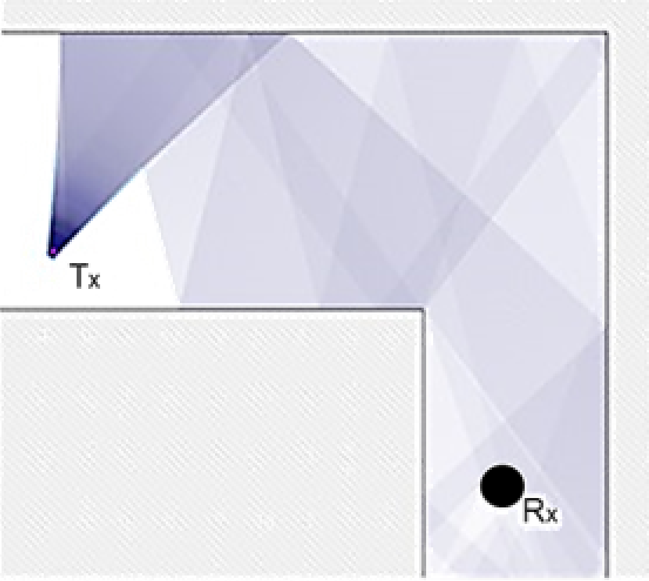
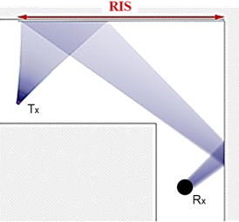
What is Reconfigurable Intelligent Surface (RIS)?
  A surface of reconfigurable metamaterials
  Control the propagation of electromagnetic wave
  Manipulate the channel to improve the signal quality
RIS
Traditional wireless communications:
Heavily rely on the environment
RIS-aided wireless communications:
Control the environment
Promising technology for future 6G communications
E. Basar, M. Di Renzo, J. De Rosny, M. Debbah, M. Alouini, and R. Zhang, “Wireless communications through reconfigurable intelligent
surfaces,” IEEE Access, vol. 7, pp. 116753-116773, Jul. 2019.

Slide 4
Outline
Basics of RIS
Existing passive RIS
Proposed active RIS
Conclusions

Slide 5

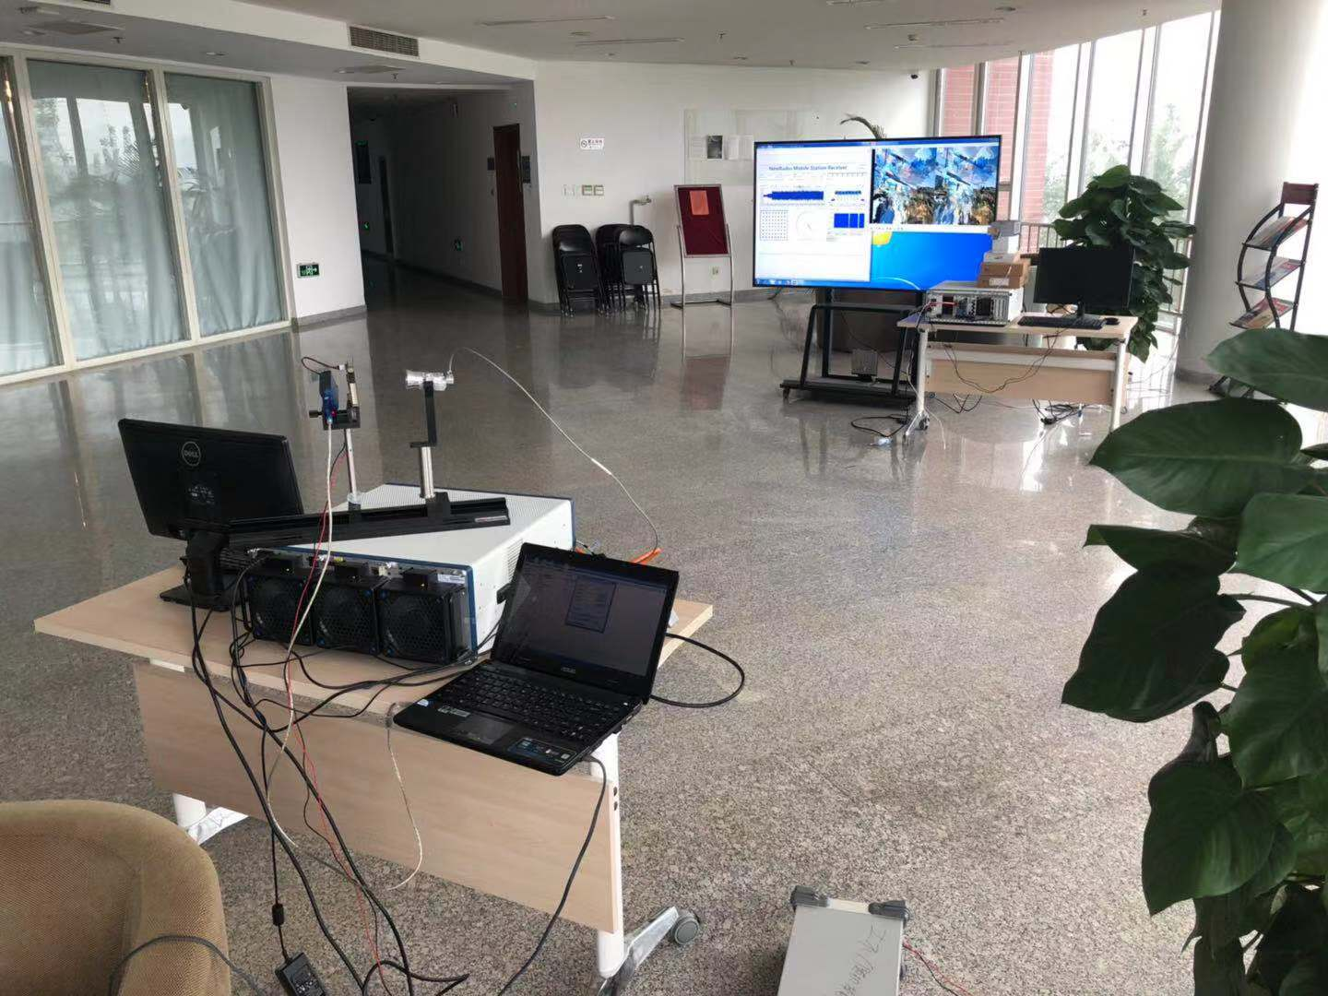
Realization of the existing passive RIS
RIS consisting of a large number of passive elements
Negligible thermal noise, low cost, low power consumption
Passive RIS
RIS-aided commutations@2.3 GHz
patch
input
phase- shift
circuit
output
Passive element
RIS-aided commutations@28 GHz
L. Dai, B. Wang, M. Wang, X. Yang, J. Tan, S. Bi, S. Xu, F. Yang, Z. Chen, M. D. Renzo, C.-B. Chae, and L. Hanzo, “Reconfigurable intelligent surface-based wireless communication: Antenna design, prototyping and experimental results,” IEEE Access, vol. 8, pp. 45913-45923, Mar. 2020. (IEEE Access Best Multimedia Award 2020)

Slide 6
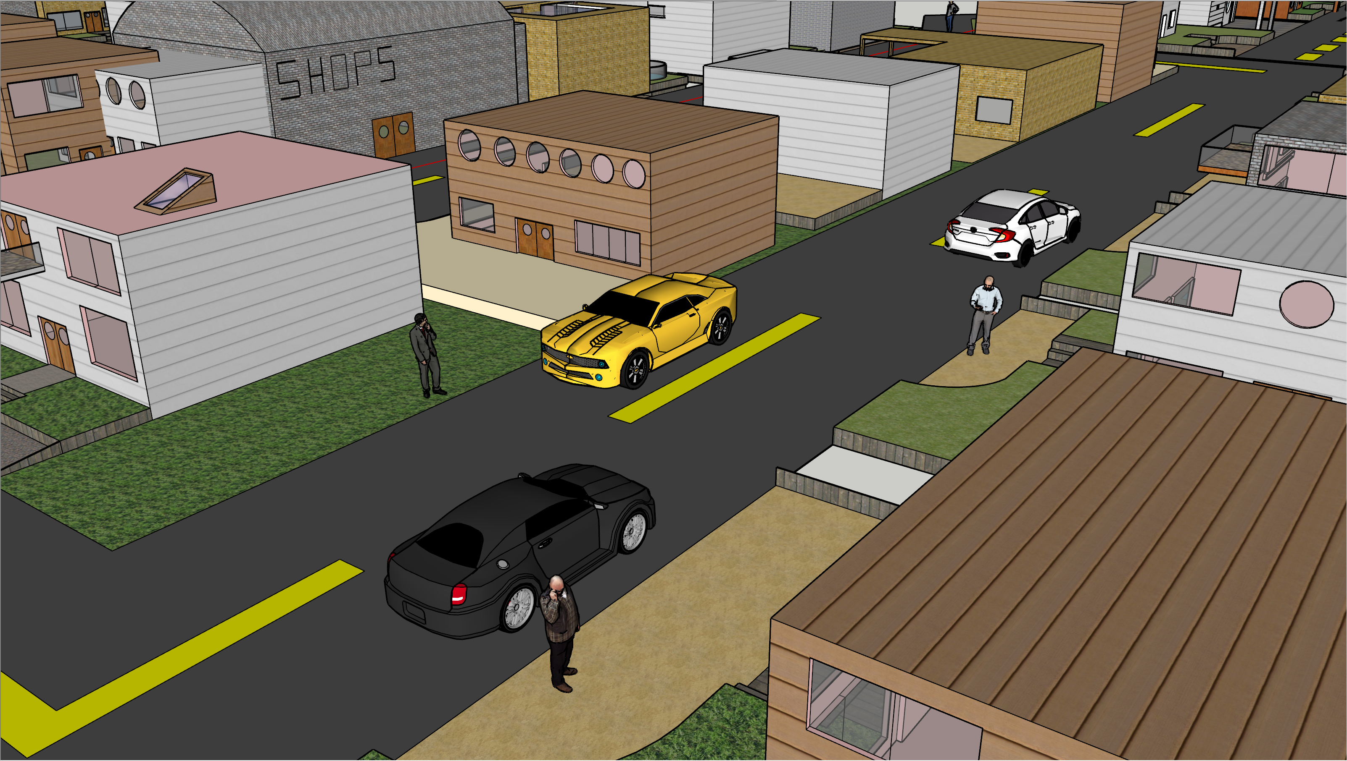
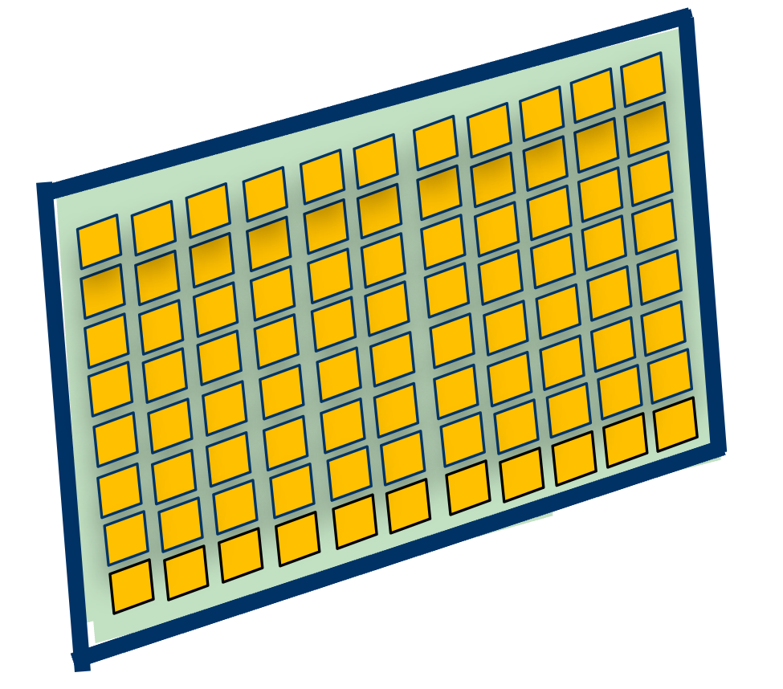
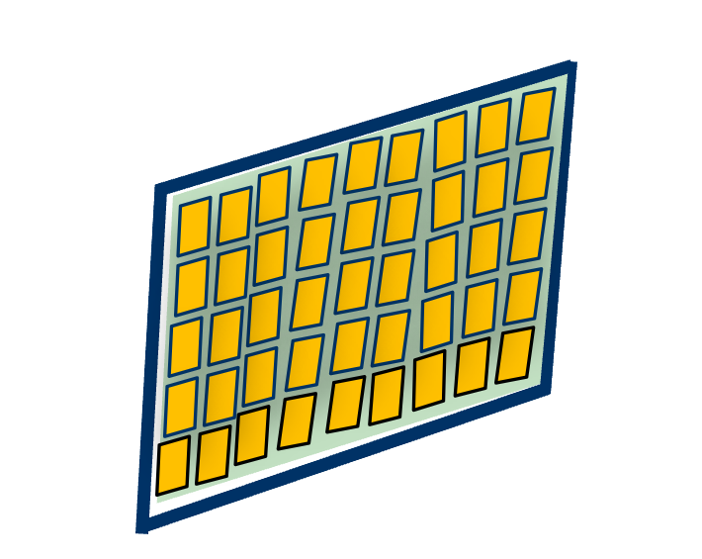
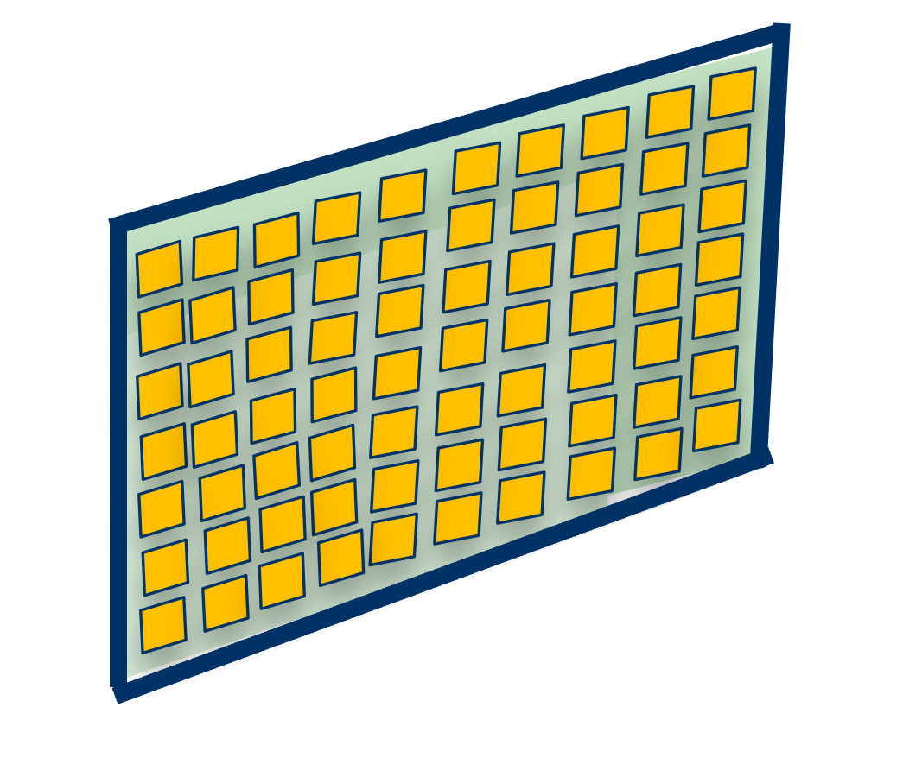

Applications of the existing passive RIS
An example: passive beamforming for capacity improvement
RIS
RIS
Transmitter
RIS
User
User
User
Transmitter
User

Slide 7








Fundamental limit: “Multiplicative fading” effect
The RIS-aided reflection link suffers large-scale fading twice
Passive RIS
Passive RIS
$$f^{H}$$
$$f^{H}$$
$$G$$
$$G$$
BS
User
BS
$$h^{H}$$
User
$$h^{H}$$
(a) Atypical scenario
(b) Typical scenario
Signal model：
$$y=\left(h^{H}+θ^{H}\text{diag}\left(f^{H}\right)G\right)ws+z$$
Product instead of summation
W. Tang, M. Chen, X. Chen, J. Dai, Y. Han, M. Di Renzo, Y. Zeng, S. Jin, Q. Cheng, and T. J. Cui, “Wireless communications with reconfigurable intelligent surface: Path loss modeling and experimental measurement,” IEEE Trans. Wireless Commun., vol. 20, no. 1, pp. 421-439, Jan. 2021.

Slide 8
Example
System parameters
  BS (equipped with 4 antennas, transmit power 10 mW)
  RIS (equipped with 256 elements)
  4 User (equipped with 1 antennas)
y
Passive RIS
(200 m, 30 m)
user 2
(0 m, 0 m)
user 1
user 3
x
user 4
(0 m, 0 m)
(500 m, 0 m)
BS
(0 m, -40 m)

Slide 9

Example
Passive RIS can only achieve negligible capacity gain in typical communication scenarios
Negligible 3%
capacity gain
Obvious 65%
capacity gain
(a) Atypical scenario
(b) Typical scenario
How to overcome the “multiplicative fading” effect
Z. Zhang, L. Dai, X. Chen, C. Liu, F. Yang, R. Schober, and H. V. Poor, “Active RIS vs. passive RIS: Which will prevail in 6G? ,” arXiv preprint arXiv:2103.15154, Mar. 2021.

Slide 10
Outline
Basics of RIS
Existing passive RIS
Proposed active RIS
Conclusions
Notes:
First, Let’s learn something about RIS.

Slide 11


Concept of active RIS
Passive RIS: Reflect signals directionally without amplification
Active RIS: Amplify the reflected signals using power amplifiers
Transmitter
Transmitter
Receiver
Receiver
reflected signal without amplification
incident
signal
incident
signal
reflected signal
with amplification
Passive RIS
Active RIS
patch
patch
input
input
phase- shift
circuit
reflection-type
amplifier
phase- shift
circuit
power
supply
output
output

Slide 12
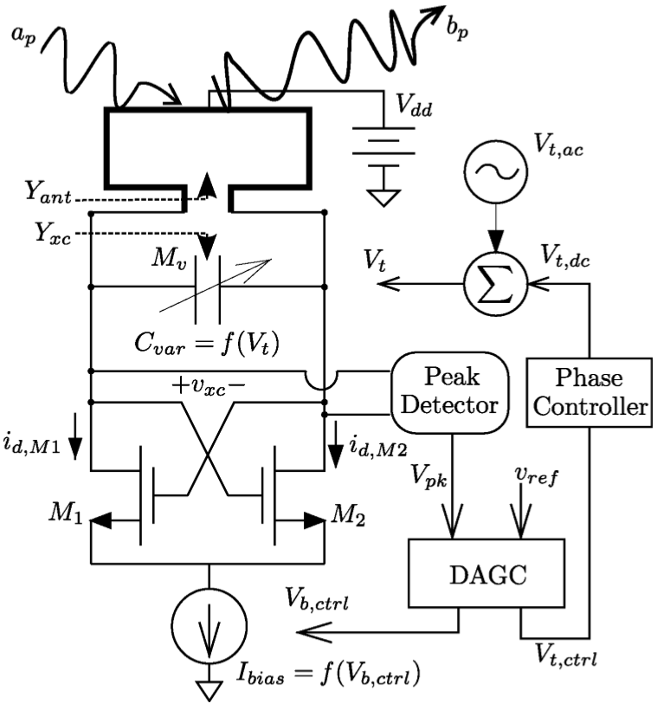
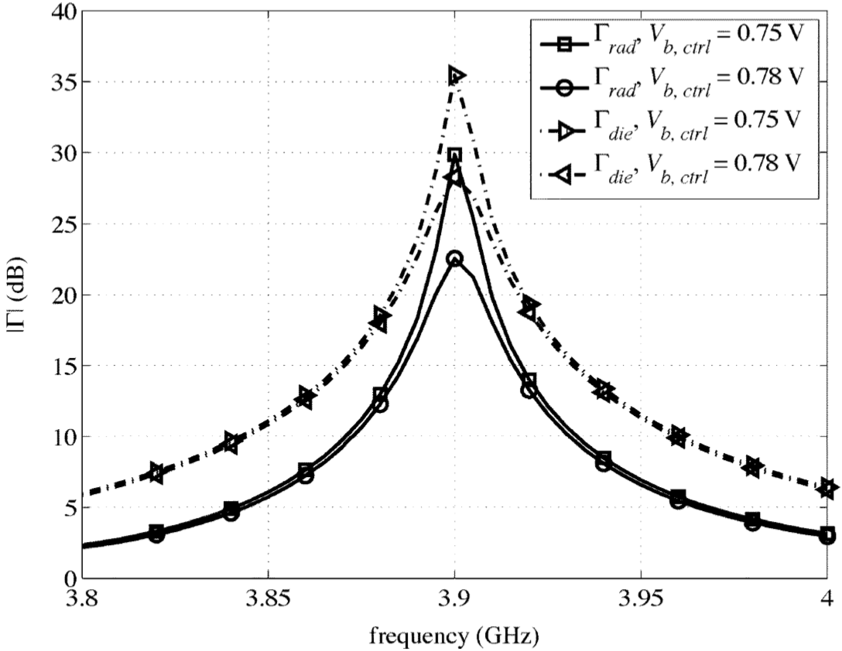
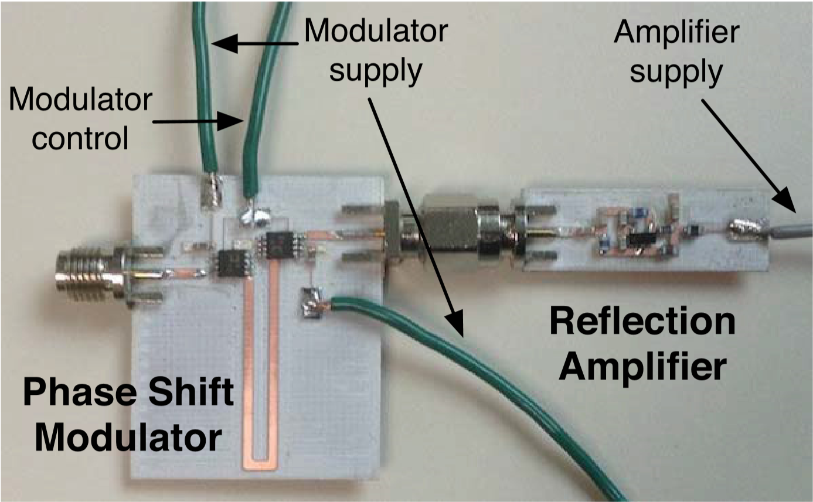
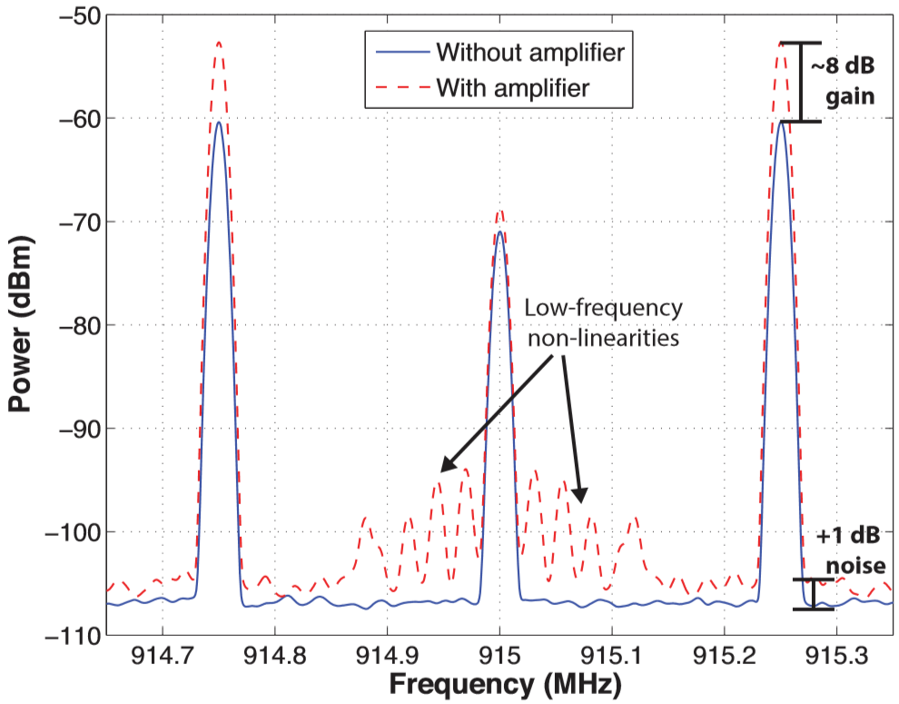
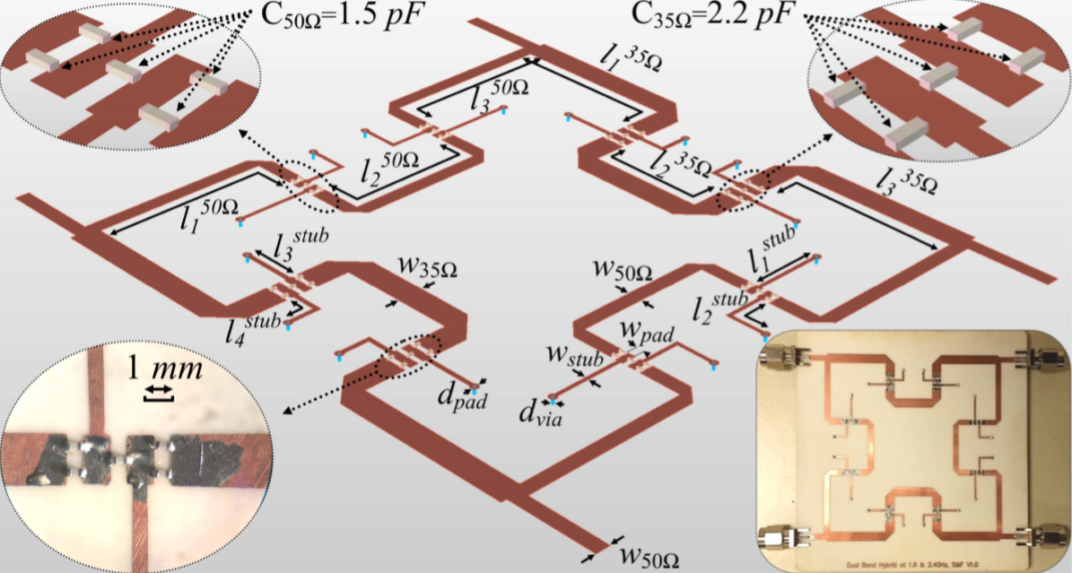
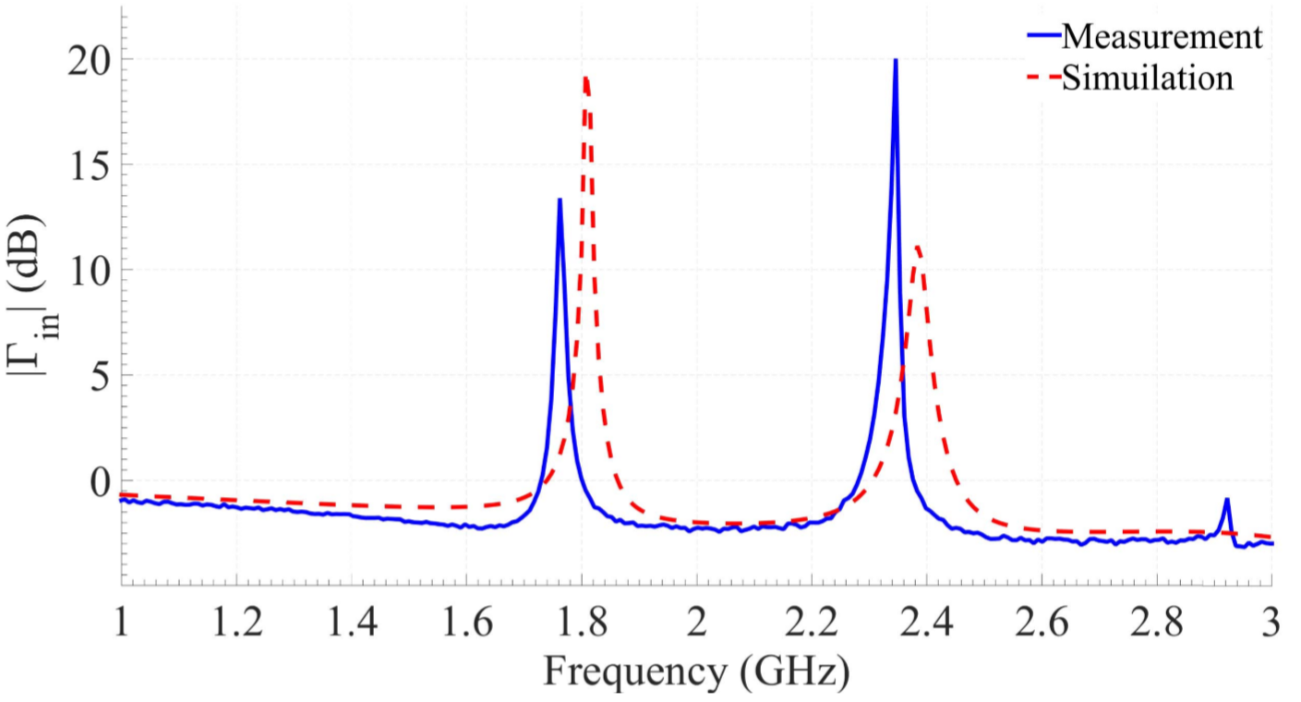
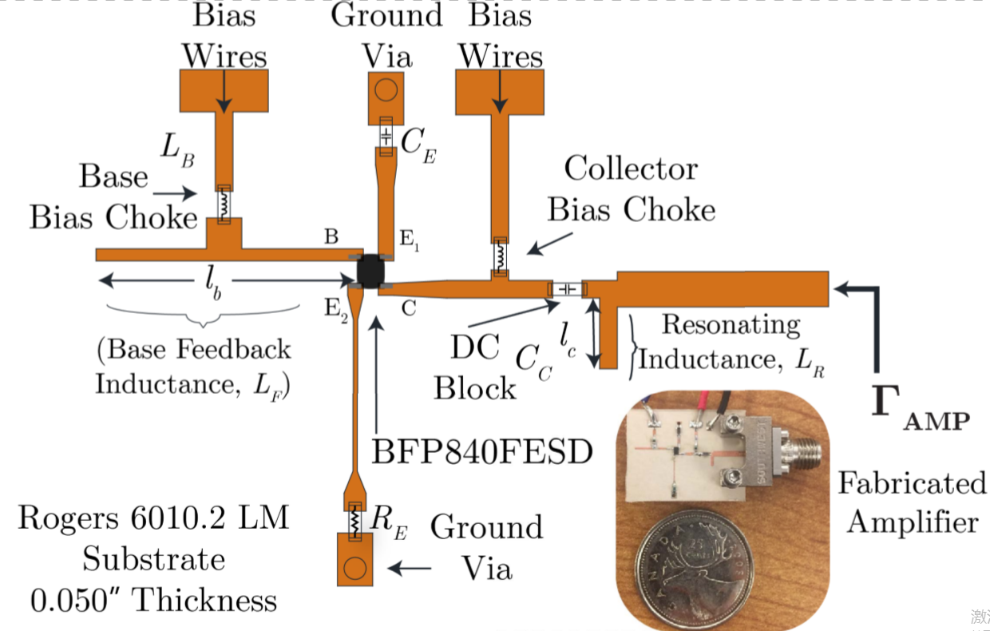
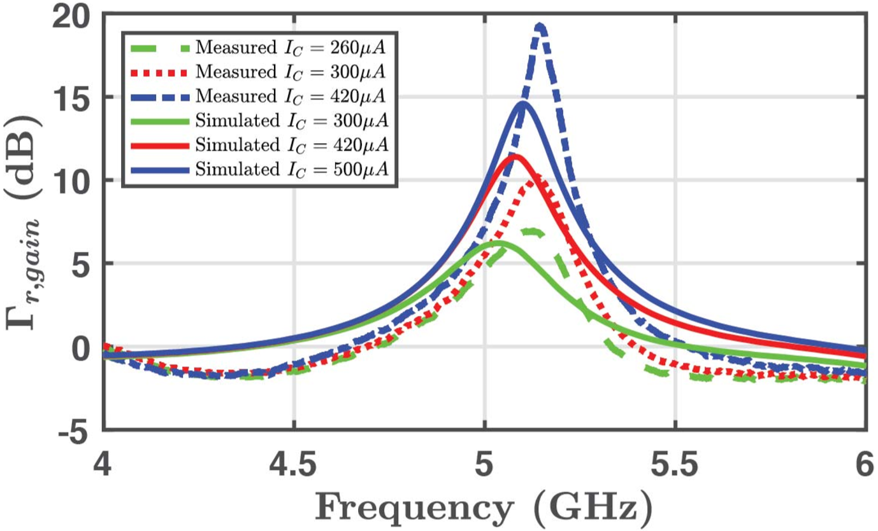
Realization of active RIS
Feasible realizations of active reflection-type power amplifier
[1]
[2]
[3]
[4]
[1] J. Bousquet, S. Magierowski and G. G. Messier, “A 4-GHz active scatterer in 130-nm CMOS for phase sweep amplify-and-forward,”
IEEE Trans. Circuits Sys. I, vol. 59, no. 3, pp. 529-540, Mar. 2012.
[2] J. Kimionis, A. Georgiadis, A. Collado and M. M. Tentzeris, “Enhancement of RF tag backscatter efficiency with low-power reflection
amplifiers,” IEEE Trans. Micro. Theory Tech., vol. 62, no. 12, pp. 3562-3571, Dec. 2014.
[3] F. Farzami, S. Khaledian, B. Smida and D. Erricolo, “Reconfigurable dual-band bidirectional reflection amplifier with applications in Van
Atta array,” IEEE Trans. Micro. Theory Tech., vol. 65, no. 11, pp. 4198-4207, Nov. 2017.
[4] P. Keshavarzian, M. Okoniewski and J. Nielsen, “Active phase-conjugating Rotman lens with reflection amplifiers for backscattering
enhancement,” IEEE Trans. Micro. Theory Tech., vol. 68, no. 1, pp. 405-413, Jan. 2020.

Slide 13







Signal model of active RIS
Different signal models of passive RIS and active RIS
patch
patch
phase- shift
circuit
phase- shift
circuit
reflection-type
amplifier
$$f^{H}$$
$$f^{H}$$
BS
$$G$$
$$G$$
BS
$$h^{H}$$
user
$$h^{H}$$
user
(a) Passive RIS
(b) Active RIS
$$y=\left(h^{H}+f^{H}Θ^{H}G\right)ws+z$$
$$y=\left(h^{H}+f^{H}PΘ^{H}G\right)ws+f^{H}Pn+z$$
Phase shift matrix
Amplification matrix
Additional noise introduced
by active components

Slide 14
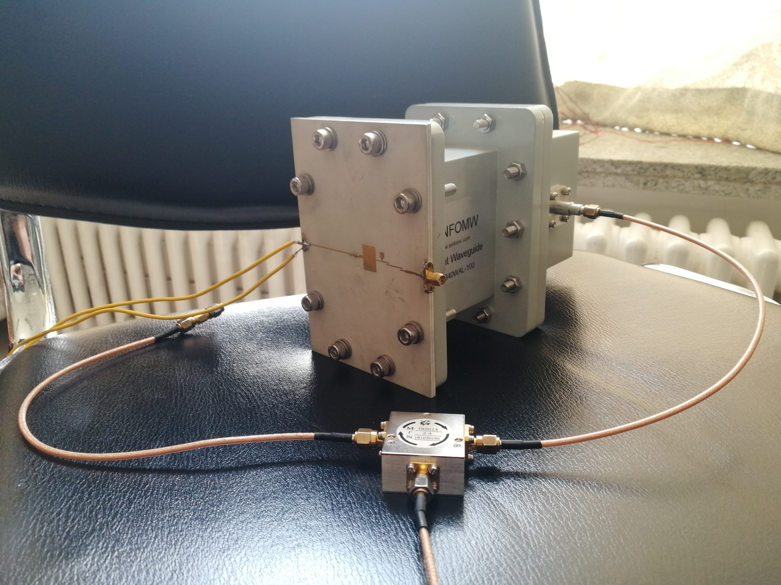
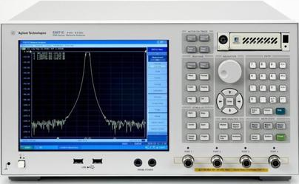
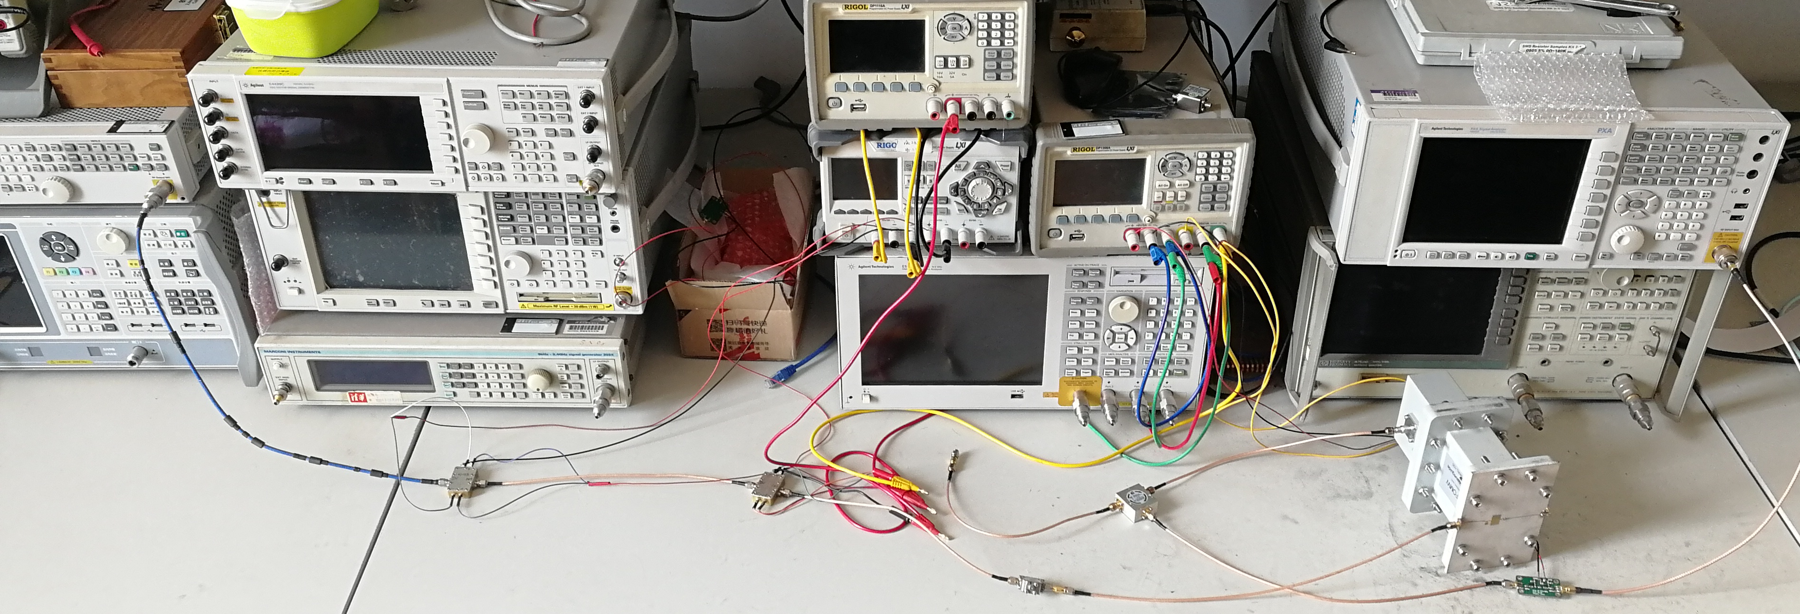
Validation of active RIS signal model
Experimental measurements of a fabricated active RIS element
power
supply
Device Under Test
patch
reflected
signals
active RIS element
incident
signals
circulator
vector network
analyzer
A fabricated active RIS element
DC source
power supply
DC source
pump
source
spectrum analyzer
vector network analyzer
active RIS
element
circulator
noise source
LNA

Slide 15

Validation results
Measurement results
25 dB reflection gain
Thermal noise
is also amplified
(a) Reflection gain vs. frequency
(b) Noise power vs. reflection gain
Verify the correctness of the proposed signal model
Z. Zhang, L. Dai, X. Chen, C. Liu, F. Yang, R. Schober, and H. V. Poor, “Active RIS vs. passive RIS: Which will prevail in 6G? ,” arXiv preprint arXiv:2103.15154, Mar. 2021.

Slide 16
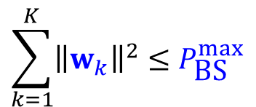

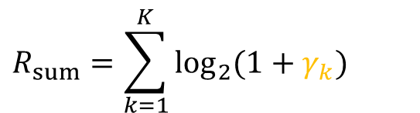
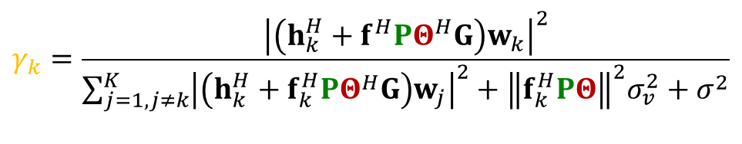


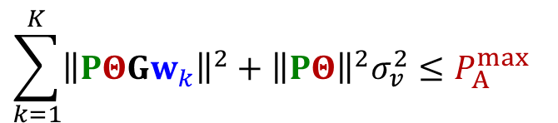
Capacity maximization of active RIS aided MIMO
$$Θ$$
Three variables: BS precoding vector , phase shift matrix , and amplification matrix of active RIS
$$w$$
$$P$$
SINR of user k
$$R_{sum}=\sum_{k=1}^{K}{\log_{2}{(1+γ_{k})}}$$
maximize
,
,
$$\sum_{k=1}^{K}{{\left\|w_{k}\right\|}^{2}}≤P_{\text{BS}}^{max}$$
BS power constraint
subject to
$$\sum_{k=1}^{K}{{\left\|PΘGw_{k}\right\|}^{2}}+{\left\|PΘ\right\|}^{2}σ_{v}^{2}≤P_{A}^{max}$$
RIS power constraint
$$γ_{k}=\frac{{\left|\left(h_{k}^{H}+f^{H}PΘ^{H}G\right)w_{k}\right|}^{2}}{\sum_{j=1,j≠k}^{K}{{\left|\left(h_{k}^{H}+f_{k}^{H}PΘ^{H}G\right)w_{j}\right|}^{2}}+{\left\|f_{k}^{H}PΘ\right\|}^{2}σ_{v}^{2}+σ^{2}}$$

Slide 17














Proposed joint precoding algorithm
$Θ$
Optimizing , , and alternatively
$$w$$
$$P$$
Lagrangian dual reformulation
optimize
Fractional programming
$$w^{opt}$$
$$w$$
optimize
optimize
Derivation
$$λ^{opt}$$
Iteration
$$P$$
$$Θ$$
$$λ$$
$$w$$
,
,
optimize
$$P^{opt}$$
$$Θ^{opt}$$
$$P$$
$$Θ$$
,
,
Fractional programming

Slide 18
Simulation for joint precoding design
Simulation parameters
  BS (equipped with 4 antennas, transmit power 10 mW)
  Active RIS (equipped with 256 elements, reflect power 10 mW)
  4 User (equipped with 1 antennas)
y
Active RIS
(200 m, 30 m)
user 2
(0 m, 0 m)
user 1
user 3
x
user 4
(0 m, 0 m)
(500 m, 0 m)
BS
(0 m, -40 m)

Slide 19
Simulation results
Active RIS can achieve noticeable capacity gain in typical communication scenarios
129%
1325%
(a) Atypical scenario
(b) Typical scenario
Active RIS can overcome the “multiplicative fading” effect
Z. Zhang, L. Dai, X. Chen, C. Liu, F. Yang, R. Schober, and H. V. Poor, “Active RIS vs. passive RIS: Which will prevail in 6G? ,” arXiv preprint arXiv:2103.15154, Mar. 2021.

Slide 20
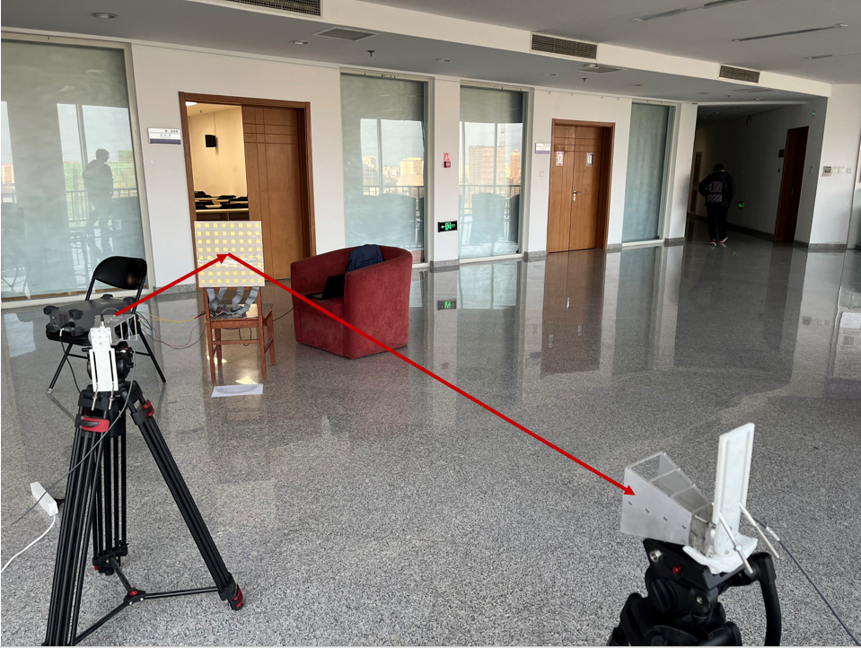
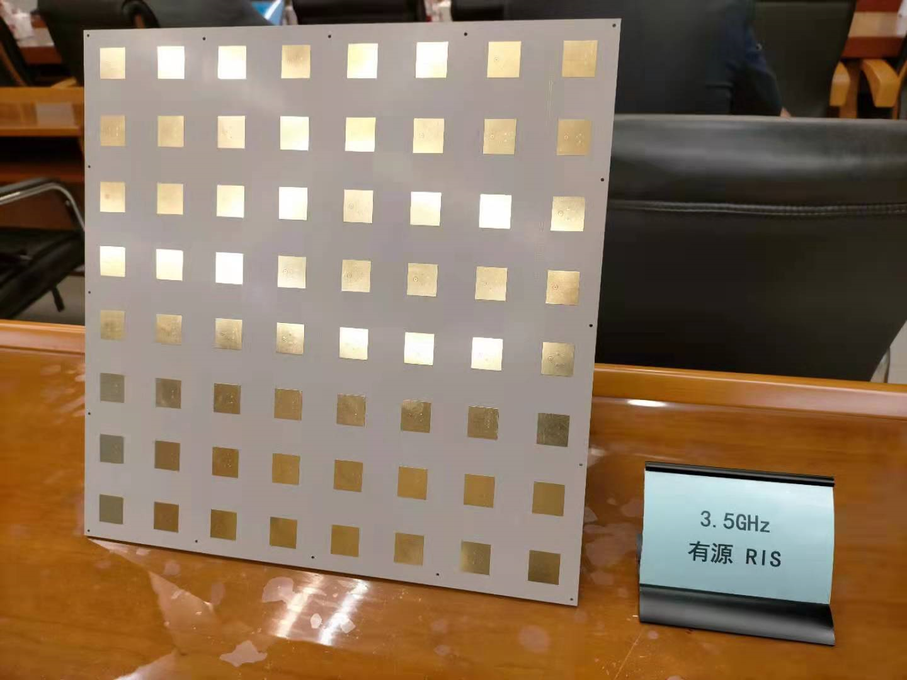
Experimental measurements of active RIS
Experimental measurements based on a 8×8 active RIS
Active RIS
BS
user
8×8 active RIS
Device | Reflection AoD | Received Power | Data Rate
Metal plate | 15° | -110 dBm | 1.2 MHz
Active RIS |  | -100 dBm | 28.5 MHz
Metal plate | 45° | -105 dBm | 1.5 MHz
Active RIS |  | -95 dBm | 30 MHz
Parameter | Setting
Frequency | 3.55 GHz
Bandwidth | 40 MHz
Polarization | Vertical (BS) Horizontal (user)
BS-RIS distance | 2 m
RIS-user distance | 3.5 m
AoA | 0°

Slide 21
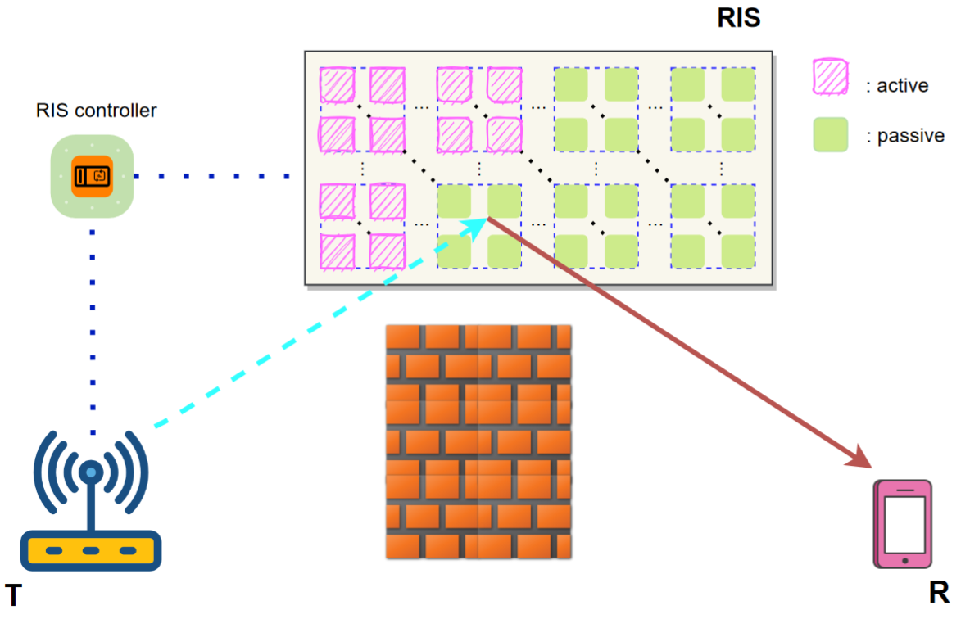
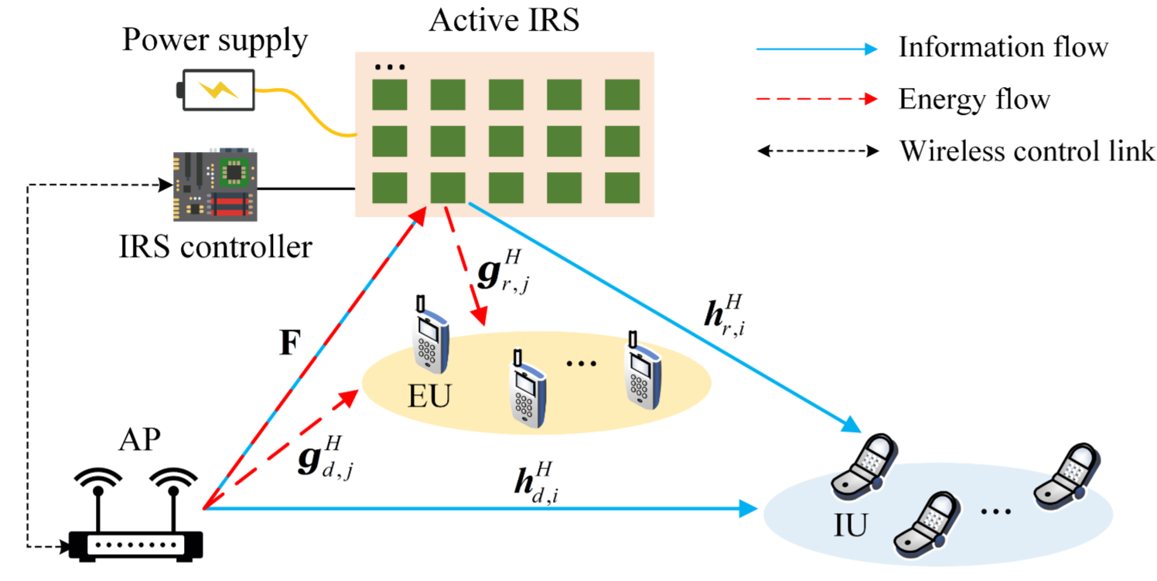
Future opportunities of active RIS
Other performance metrics optimization for active RIS
Channel estimation for active RIS aided system
Hybrid passive and active RIS architecture
Active RIS for other techniques, e.g., security, NOMA, MEC, etc.
[1] E. Basar and H. V. Poor, “Present and future of reconfigurable intelligent surface-empowered communications,” IEEE Signal Process. Mag.,
vol. 38, no. 6, pp. 146-152, Nov. 2021.
[2] Z. Yigit, E. Basar, M. Wen, and I. Altunbas, “Hybrid Reflection Modulation,” arXiv preprint arXiv:2111.08355, Nov. 2021.
[3] R. Long, Y.-C. Liang, Y. Pei, and E. G. Larsson, “Active reconfigurable intelligent surface aided wireless communications,” IEEE Trans.
Wireless Commun., vol. 20, no. 8, pp. 4962–4975, Aug. 2021.

Slide 22
Outline
Basics of RIS
Existing passive RIS
Proposed active RIS
Conclusions

Slide 23
Conclusions
  Basics of RIS
    Reconfigure the wireless environment
  Existing passive RIS
    Passively reflect signals without amplification
    Fundamental limit: “multiplicative fading” effect
    Only achieves negligible capacity gain in typical scenarios
  Proposed active RIS
    Reflect signals with amplification to overcome “multiplicative fading” effect
    New signal model verified by experimental measurements
    Achieves noticeable capacity gain in typical scenarios
    Recent test results based on an 8*8 active RIS
Passive RIS Active RIS

Slide 24






Zijian Zhang
Fan Yang
Robert Schober
Vincent Poor
Thanks
Reproducible Research: http://oa.ee.tsinghua.edu.cn/dailinglong/

